Slide 1




Virtusa Project Report
Project Title: Art Gallery Management System
Team Name: TestNG Team
Mentor Name: Mohana K.V.S.S. Prasad Jakka

Slide 2
Agenda
Introduction
Framework &
Tools
Test Scenarios
Demonstration
Standard Practices

Slide 3
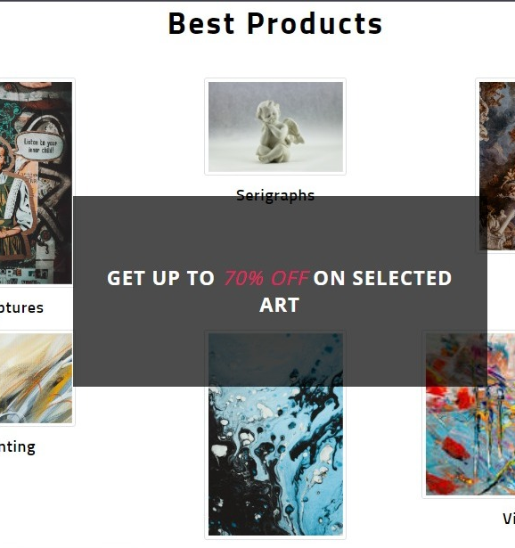
Introduction to Automation Project Using Selenium and TestNG
This project aims to streamline the management processes of art galleries through automation and efficient testing.
In this presentation, we will explore the key features and advantages of our automation project, highlighting its significance in the art gallery industry.
By automating repetitive tasks, we enable administrators to save time and improve productivity.
Our project encompasses functionalities such as artwork art products management, artist information management, and customer engagement. We will showcase the automation by emphasizing the synergy between Selenium and TestNG.
Website Link: http://artgallery.neohire.io/
3

Slide 4

Framework & Tools
TestNG
Selenium-Java
TestNG stands for "Test Next Generation" and is designed to overcome the limitations of traditional testing frameworks.
TestNG offers advanced functionalities such as parallel test execution, test dependency management, and flexible test configuration.
Selenium supports multiple browsers such as Chrome, Firefox, Safari, and Edge, ensuring compatibility across different platforms.
With Selenium, testers can simulate user interactions, perform data-driven testing, and handle complex scenarios easily.
Selenium supports multiple programming languages like Java
Framework & Tools
4

Slide 5
Test Scenarios
Test Scenario ID | Testcase Name | Test Scenario Description | Special Condition | Status
TS_Admin_01 | Add Artist | Add Artist is admin scenario to add new artist and their details | Check information is unaltered. | Pass
TS_Admin_02 | About Us | About us is a admin scenario where we handle user and admin section to update website details. | Handling admin and user simultaneously updating the information at user side and verifying the same | Pass
TS_User_03 | Search | User scenario for product search | 2.5 | Pass
Excel Link: https://docs.google.com/spreadsheets/d/1a7TU9Ytwlz8i_Xiz_YxsfvLsA3SRemJ/edit?usp=drive_link&ouid=104031076061512572077&rtpof=true&sd=true
5

Slide 6
Workflow
Login to admin and navigate to “Add Artist” under artist
Fill out the artist details & click on submit.
Navigate to “Manage Artist” and fetch.
Fetch the details of artist and verify the same.
Logout from admin portal.
Login to admin and navigate to “About Us” under Pages.
Fill out the website details & click on submit.
Navigate to the user section.
Verify the details updated.
Logout from admin portal
Navigate to Art type in navbar and select the option of dropdown.
In the product page enter the product name in search input
Fetch the displayed products cards else fetch message.
Verify the searched input to the product name.
Navigate back to the homepage.
6

Slide 7


Demonstration
Art
Gallery
Management
System

Slide 8
Standard Practices
Extent Report
Modular Structure
To generate comprehensive and visually appealing reports.
Breaking down the code into reusable modules allows for easier maintenance, updates, and scalability.
Annotations
Allow you to set up preconditions, perform cleanup actions, and control test execution flow.
Groups and Dependency Test
Setup Driver Single Instance
To provide functionality for you to categorize test cases into logical groups and implanting dependency
To ensure efficiency and avoid unnecessary resource consumption.
8

Slide 9






Meet Our Team
Aditya Dalvi
Anuj Jadhav
Leader
A Dheeraj
Vinathi Botlagunta
Chandana Vanteru
Aakash Kumar
9

Slide 10
THANK YOU
Team TestNG

